Slide 1
German Traffic Sign Recognition Benchmark
Neilam Rathod

Slide 2
agenda
INTRODUCTION
PRIMARY GOALS
STEPS
RESULTS
SUMMARY
REFERENCE

Slide 3

Introduction
In this capstone project attempts to recognize the German traffic signs. Using multi class CNN(Convolution neural network) on data of samples with 51888 images and 43 class

Slide 4
primary goals
1)Explore and understand the data
2)Data Visualization
3)Learn new model and new library for making process time efficient and smooth
4) Predicting the model on test data.

Slide 5
STEPS INVOLVED
1) Data Extraction – GTSRB on Kaggle computer vision projects
2) Data Preparation – Join the images in respective path with directory from google drive.
3) Data- Preprocessing – creating label for 43 class and join with respective images , loading Train data of over 29888 images , preprocessing the images in array and convert to dataframe .
4) Extrapolatory Data Analysis - Inference Data is skewed on some labels , causing unbalanced data , plot Random images with their respective labels.
5) Data balancing – Fixing number of sample - Distribution of 200 number samples equally in all 43 classes.
6) Split Data – train and test of train data
7) Model Creation and Evaluation – The CNN model architecture consists of several convolutional and pooling layers, followed by fully connected layers and a SoftMax activation function for multi-class classification. The model is trained using the Adam optimizer and categorical cross-entropy loss function.
8) Hyperparameter Tunning – fixing Learning rate 0.001, epochs to 30 , Optimizer Adam and cross-entropy loss. Image Augmentation of images
9) Saving model and Predicting of test datasets.

Slide 6
DATA
German Traffice Sign Reconginiztion Benchmark
2)Original data with 1lakh+ images in Train , test and meta folder , with 43 class.
3)Duplicated images almost double in meta reducing to 51888 images , train data 29888 samples.

Slide 7
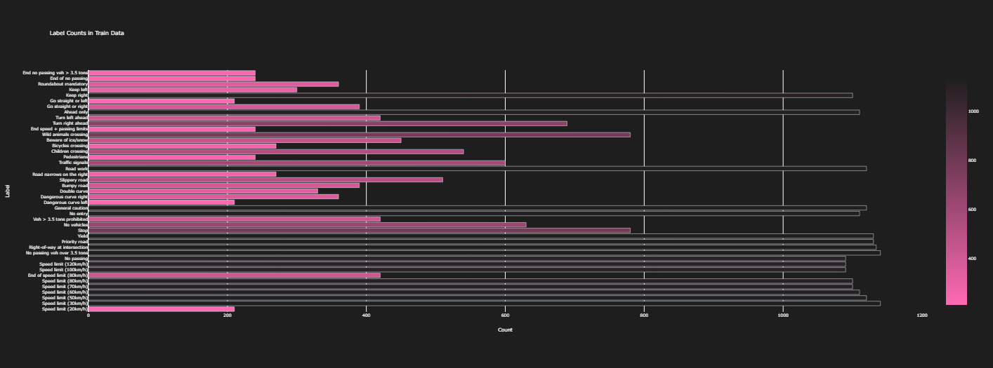

EDA
Label distribution horizontal bar and PiE chart
PIE CHART
HoriZontal BAR

Slide 8
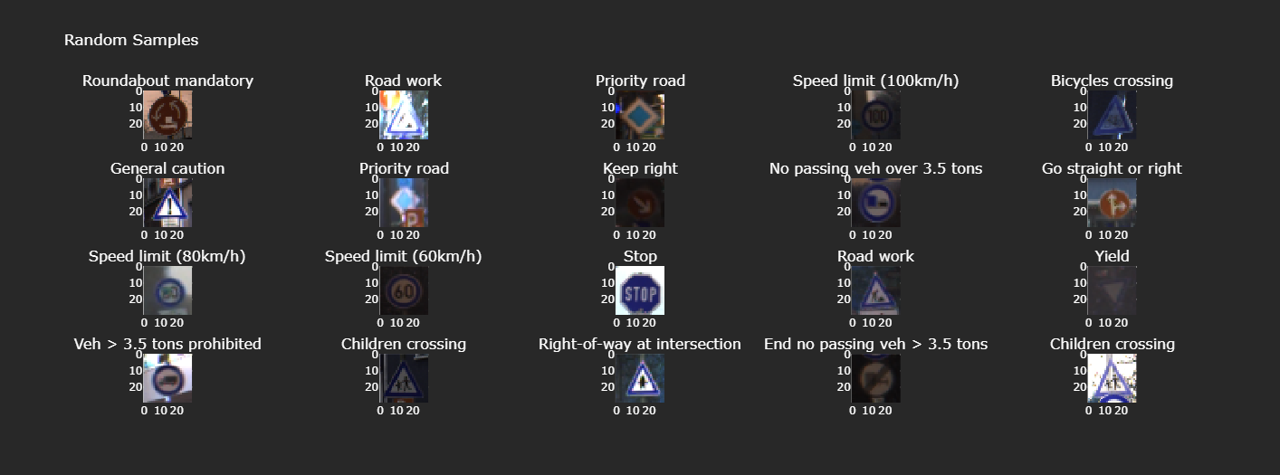
EDA
Random Samples Images with class
Samples

Slide 9

EDA
FIXING THE SAMPLES each class
Samples

Slide 10
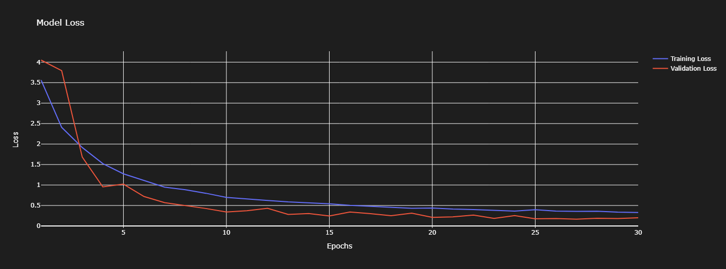
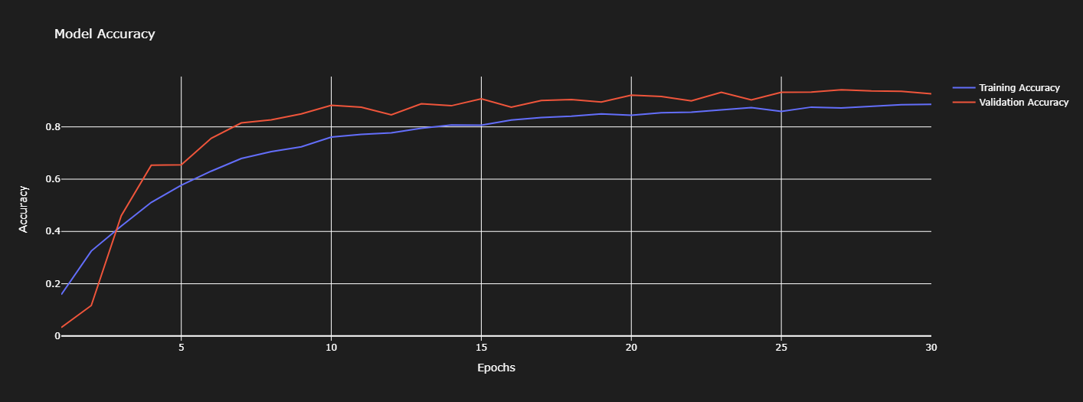
Results
MODEL LOSS
MODEL ACCURACY

Slide 11
Interpretation
CNN
The traffic sign recognition model notebook provides a comprehensive analysis and prediction model for recognizing traffic signs. By using deep learning techniques and the provided dataset, the notebook demonstrates how to preprocess the images, build a convolutional neural network (CNN) model, and evaluate its performance using accuracy as the metric. The notebook also showcases the effectiveness of data augmentation techniques in improving the model's performance.
The CNN model architecture consists of several convolutional and pooling layers, followed by fully connected layers and a softmax activation function for multi-class classification. The model is trained using the Adam optimizer and categorical cross-entropy loss function.
By training the model on the traffic sign dataset, the notebook demonstrates how to achieve high accuracy in recognizing and classifying different traffic signs. The model can be used in real-world applications to aid in automated traffic sign detection and recognition systems.
Overall, this notebook serves as a valuable resource for understanding and implementing traffic sign recognition using deep learning techniques.
Further Implementation
The more advance model like R-CNN , LeNet5 ,Alex Net , Google Net , VGG Net to name few .CNN computer vision is vast field in which models get update more advance day in and day out . So one who wants to dive deep into computer vision , one should get good grasp of more advance CNN models.
.

Slide 12
Thank you
Neilam Rathod
neilam91721@gmail.com

